Slide 1
Discovering SQL
INSTALLING
MySQL 5.1
Community Server

Slide 2

Download MySQL 5.1 from the MySQL official site:
http://dev.mysql.com/downloads/mysql/
Windows (x86, 32-bit), MSI Installer
Double click on the mysql-5.1.49-win32.msi icon

Slide 3
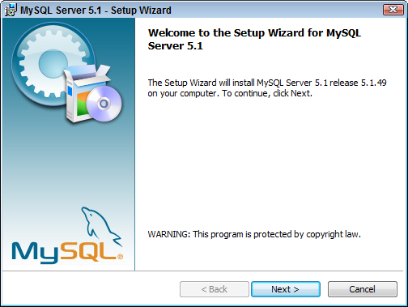
Click [Next] button

Slide 4
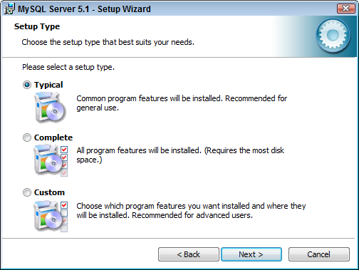
Select the Typical installation option
Click [Next] button

Slide 5
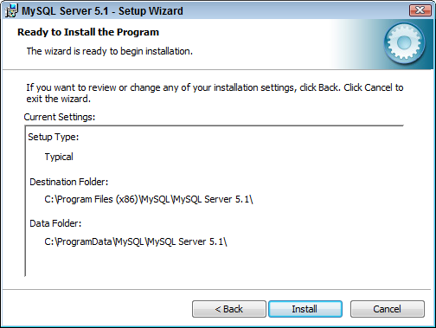
Click [Install] button

Slide 6
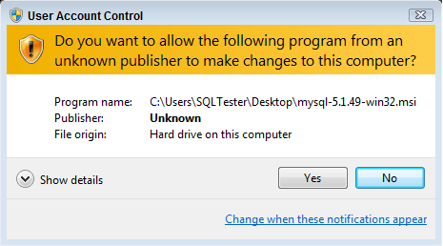
Click [Yes] button to allow the installation

Slide 7
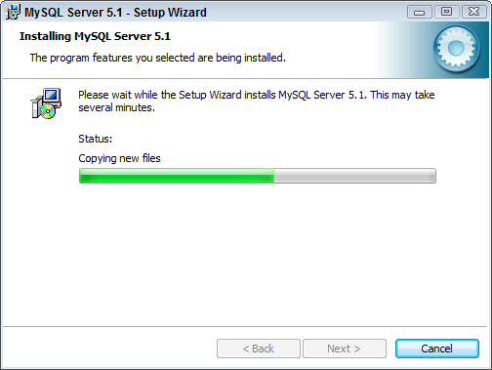
The installation can take some time depending on
your computer’s hardware configuration

Slide 8
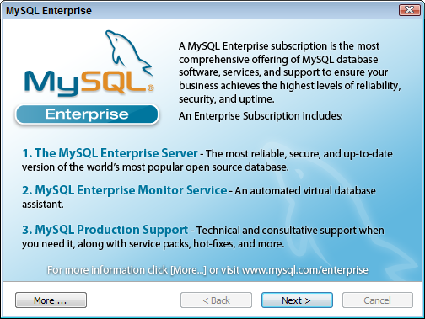
Click [Next] button

Slide 9
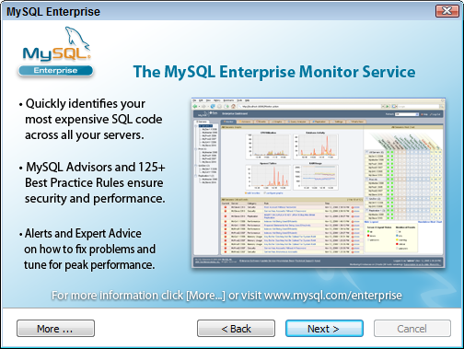
Click [Next] button

Slide 10
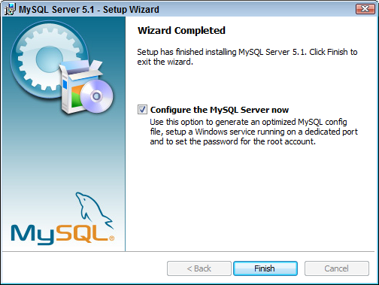
While configuration could be performed at later time, this tutorial does it as part of the installation process.
Click [Finish] button

Slide 11
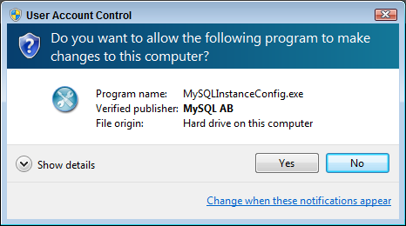
Click [Yes] button to continue the setup

Slide 12
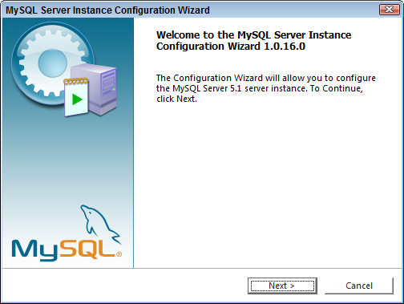
Click [Next] button

Slide 13
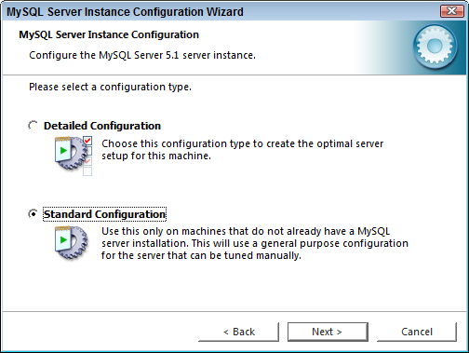
Select the Standard Configuration option
Click [Next] button

Slide 14
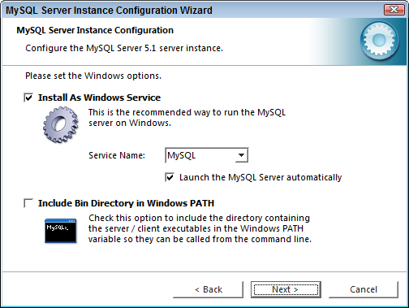
On Windows machines it is recommended to install server-type software as “Windows Service” as opposed to application. The advantages are that the MySQL server could start automatically on the machine startup, and will run in background thus utilizing fewer resources
Select the Install As Windows Service option; check box to include MySQL \bin directory in Windows PATH environmental variable – this will facilitate using MySQL from command line.
Click [Next] button

Slide 15
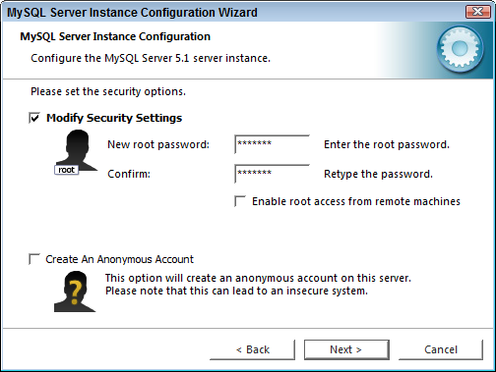
Password for administrative account is the key to the kingdom. Make it reasonably secure and safeguard it. Creating an Anonymous Account would allow anyone to connect to your database server without user ID and password; this could be potentially compromise security in your environment
Select the Modify Security Settings option and
select the root password
Click [Next] button

Slide 16
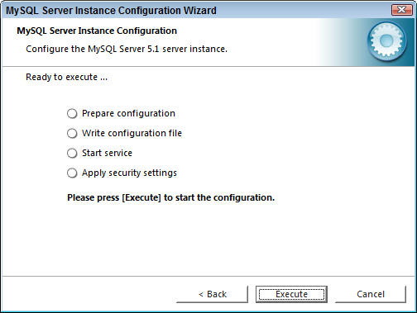
Click [Execute] button

Slide 17
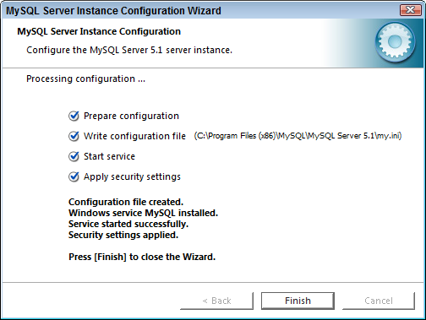
Click [Finish] button

Slide 18
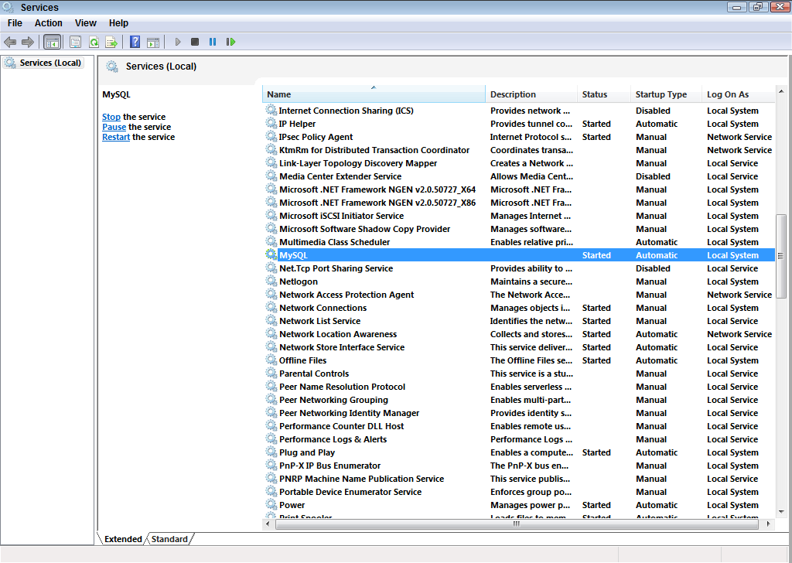

This screen shows the MySQL 5.1 database service running on your Windows machine (the console is accessible from the Administrative Tools menu).

Slide 19
MySQL 5.1 Community Server
MySQL Community Server is a full featured free open source relational database server popular used by many open source projects as storage engine
Acquired by Oracle Corporation in 2009, MySQL is currently released under GNU General Public License (version 2, with linking exception)

